Slide 1

personalized recommendation system
SCREEN SENSE
INFOSYS SPRINGBOARD INTERNSHIP

Slide 2

PROJECT OVERVIEW
Build a data-driven recommendation system to analyze screen-time and provide personalized insights.
End-to-end analytics pipeline (data → features → model → output)
Interactive Power BI dashboard for visual insights
Full-stack application (FastAPI backend + React frontend)
Behavioral pattern insights based on screen-time trends

Slide 3
DATASET OVERVIEW
Demographics: Age, Gender
Device Type: Mobile, Laptop, Tablet
Activities: Educational, Recreational, Gaming, Social Media
Screen Time Metrics: Daily hours, session distribution
Health Impacts: Eye strain, headache, anxiety
Dataset Used: Indian Kids Screen-Time Dataset 2025
Reason for Selection:
Highly relevant dataset with rich behavioral attributes suitable for building recommendations.

Slide 4

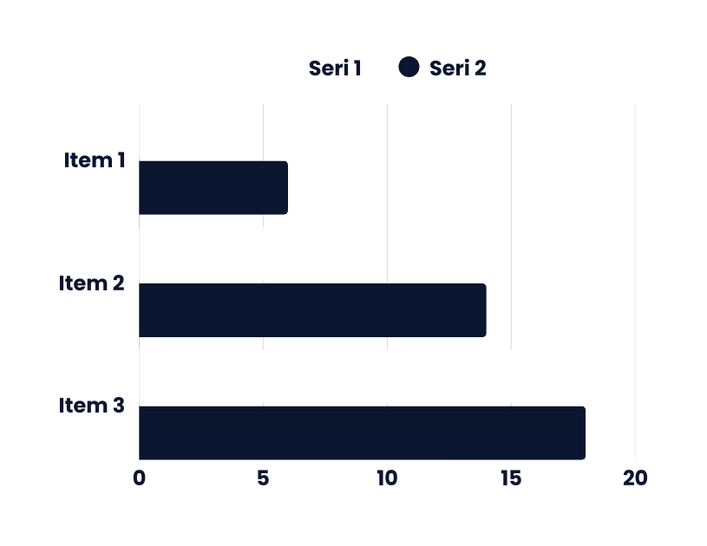
KEY INSIGHTS EXTRACTED
Recreational screen time is significantly higher than educational usage.
Mobile devices account for the majority of daily screen hours.
Teenagers (13–17 age group) show the highest daily screen time.
Increased screen time correlates with eye strain, poor sleep, and anxiety.
Evening and late-night screen usage contributes most to high-risk behavior.

Slide 5
METHODOLOGY
Data Collection from structured dataset
Data Cleaning & Preprocessing to remove noise and inconsistencies
Feature Engineering (total screen time, ratios, age grouping)
Exploratory Data Analysis for pattern identification
Prototype Development in Jupyter Notebook
Backend Development with FastAPI for prediction & recommendation APIs
Frontend Development with React.js for user interaction
Power BI Dashboard for visual insights
System Integration & Testing ensuring smooth flow

Slide 6
DATA PREPROCESSING
Removed duplicates and invalid records
Handled missing values through imputation
Standardized inconsistent activity labels
Created meaningful derived features:
Total Screen Time (hrs/day)
Edu/Rec Screen-Time Ratio
Age Category Segmentation
Converted categorical variables into uniform formats for analysis

Slide 7
EXPLORATORY DATA ANALYSIS
Univariate Analysis: Distribution of screen time across age groups
Bivariate Analysis: Relationship between screen time and health symptoms
Category Comparison: Activity type vs screen hours
Weekday vs Weekend Usage: Higher recreational time on weekends
Device-Level Breakdown: Dominance of mobile usage
Correlation Study: Strong link between long usage hours and health impacts

Slide 8
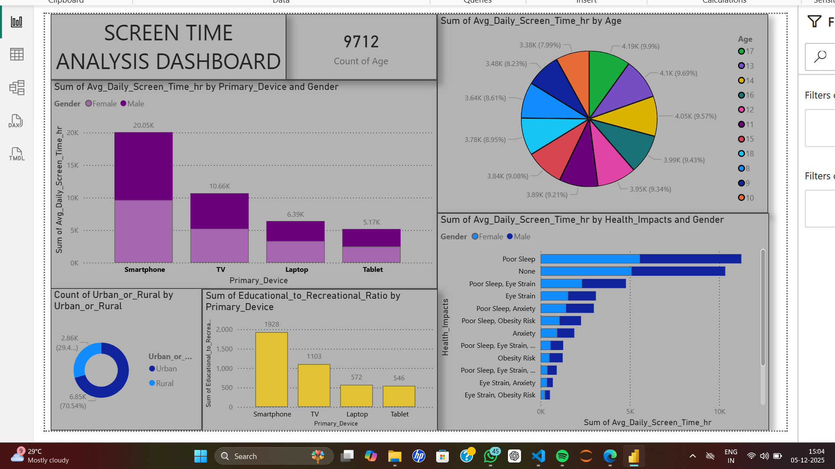

Slide 9
SYSTEM ARCHITECTURE & APPLICATION
Architecture Flow
User
→ React Frontend
→ FastAPI Backend
→ Logic Engine
→ Output: Prediction + Recommendations
Application Features
Personalized recommendation generator
Health impact analysis & alerts
Clean, responsive UI
API-driven result display
Power BI insights for analytics
Prototype Versions
Console Prototype
Built in Jupyter Notebook to validate logic
Web Application
Full-stack version offering real-time

Slide 10
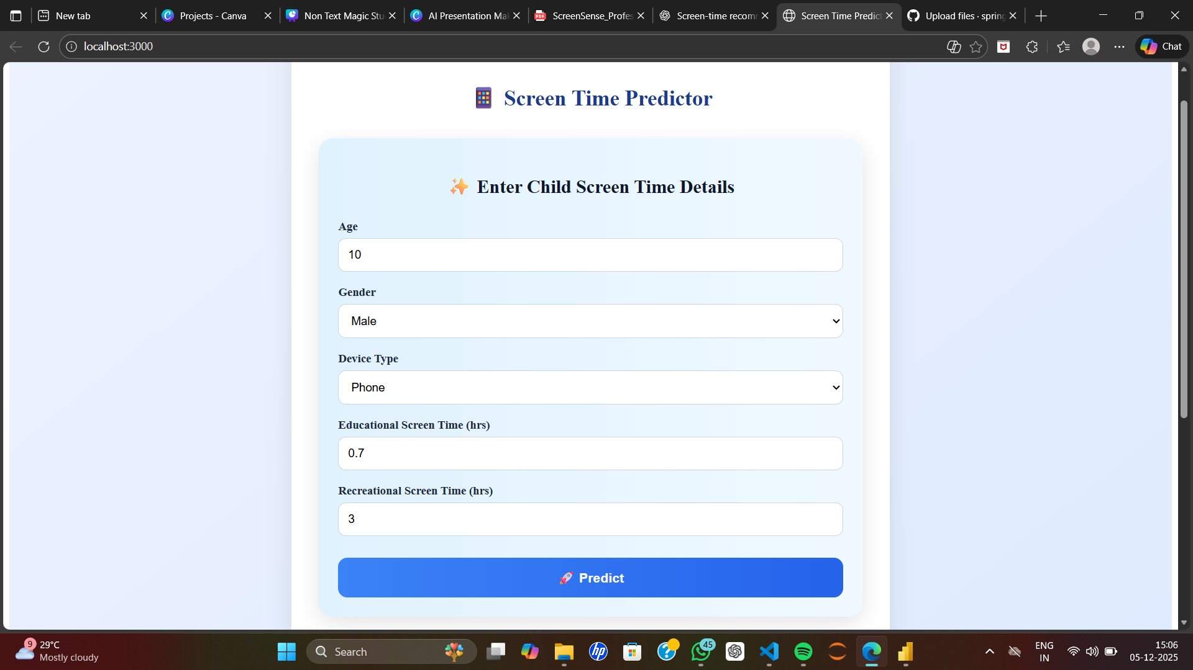
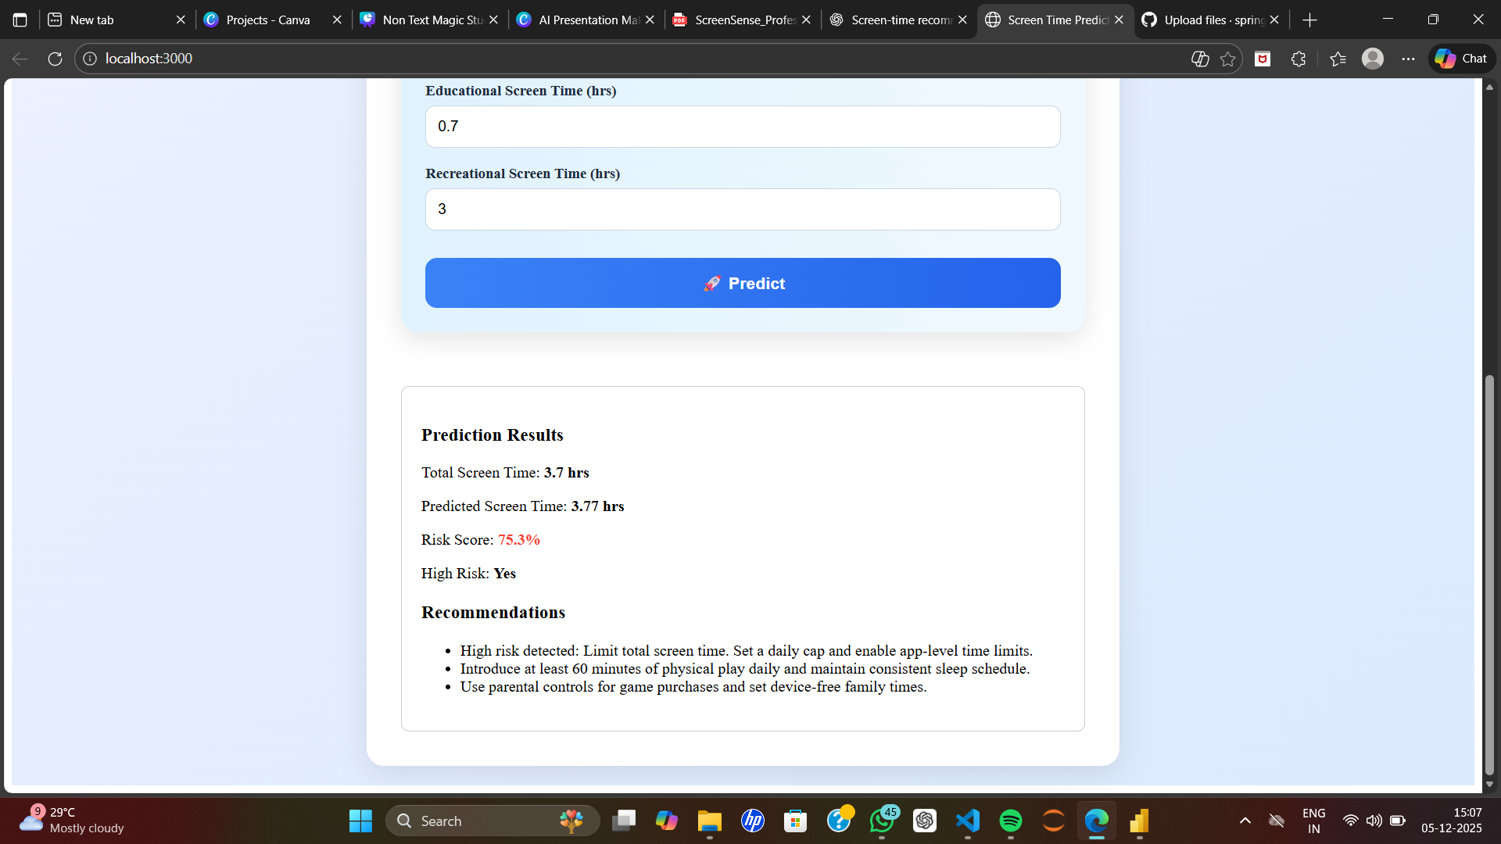

Slide 11
CONCLUSION
Key Results
Working data pipeline from raw data → insights → recommendations
Functional recommendation engine based on screen-time patterns
Interactive dashboards highlighting behavioral trends
Successful integration of backend and frontend
Conclusion
This project delivers a complete behavioral analytics and recommendation system, offering insightful screen-time analysis and guiding users toward healthier digital habits.

